Slide 1
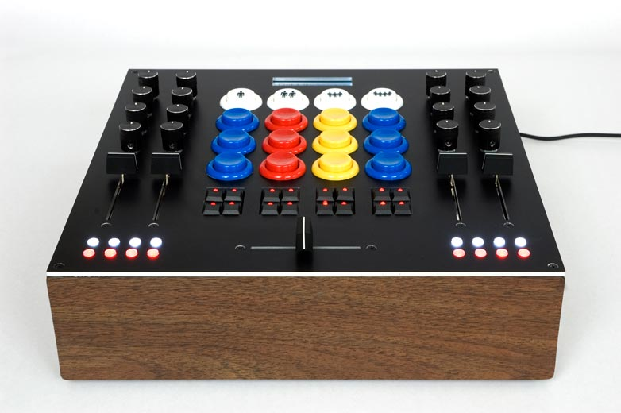
https://flic.kr/p/4MRZPn
MVC Controllers

Slide 2
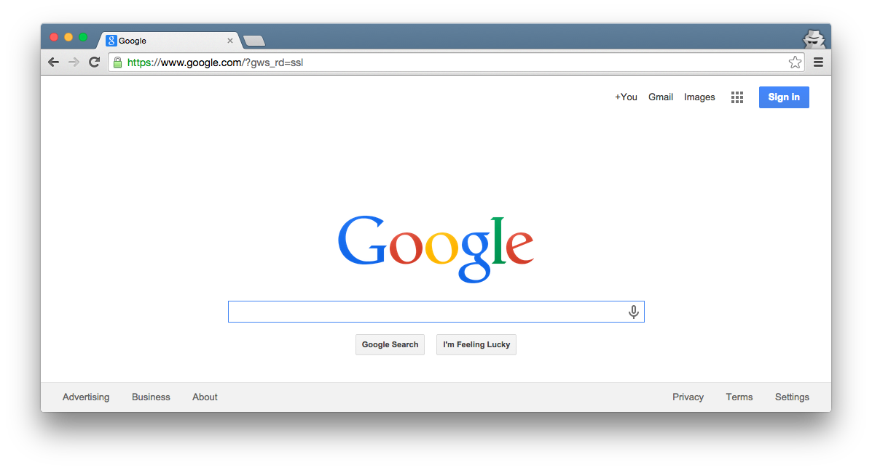

Browser
Ye Olde
Internet
DB
Server
Today’s focus
View
Router
Controller
Model

Slide 3
5 Basic Controller Patterns
Create
  new/create: Enter a new record
Read
  index: List all records
  show: Display a particular record
Update
  edit/update: Modify an existing record
Delete
  destroy: Remove a record

Slide 4
5 Basic Controller Patterns
Create
  new/create: Enter a new record
Read
  index: List all records
  show: Display a particular record
Update
  edit/update: Modify an existing record
Delete
  destroy: Remove a record

Slide 5
Browser
How to implement index?
Ye Olde
Internet
DB
Server
View
Router
Controller
Model

Slide 6
Browser
How to implement index?
Route “index” URL pattern
Controller uses Model to retrieve records
Controller uses View to generate HTML (passes records to View)
Ye Olde
Internet
Demo Time!
DB
Server
View
3
1
Router
Controller
Model
2

Slide 7
5 Basic Controller Patterns
Create
  new/create: Enter a new record
Read
  index: List all records
  show: Display a particular record
Update
  edit/update: Modify an existing record
Delete
  destroy: Remove a record
✔

Slide 8
Browser
How many HTTP requests does it take to create a record?
Ye Olde
Internet
DB
Server
View
Router
Controller
Model

Slide 9
Browser
How many HTTP requests does it take to create a record?
Two:
One to request a form (GET)
One to perform the add (POST)
Ye Olde
Internet
DB
Server
View
Router
Controller
Model

Slide 10
Browser
How to implement get form?
Ye Olde
Internet
DB
Server
View
Router
Controller
Model

Slide 11
Browser
How to implement get form?
Route URL pattern
Controller uses View to generate HTML (passes View records)
Ye Olde
Internet
DB
Server
View
2
1
Router
Controller
Model

Slide 12
Browser
How to implement post new record?
Ye Olde
Internet
DB
Server
View
Router
Controller
Model

Slide 13
Browser
How to implement post new record?
Route URL pattern
Controller uses Model to add rec
Controller sends HTTP redirect
Ye Olde
Internet
Demo Time!
DB
Server
View
3
1
Router
Controller
Model
2

Slide 14
5 Basic Controller Patterns
Create
  new/create: Enter a new record
Read
  index: List all records
  show: Display a particular record
Update
  edit/update: Modify an existing record
Delete
  destroy: Remove a record
✔
✔
Like index
Like create
Needs explaining…
Demo Time!

